Slide 1
Lecture 8
Bacteriophage Cloning vectors

Slide 2
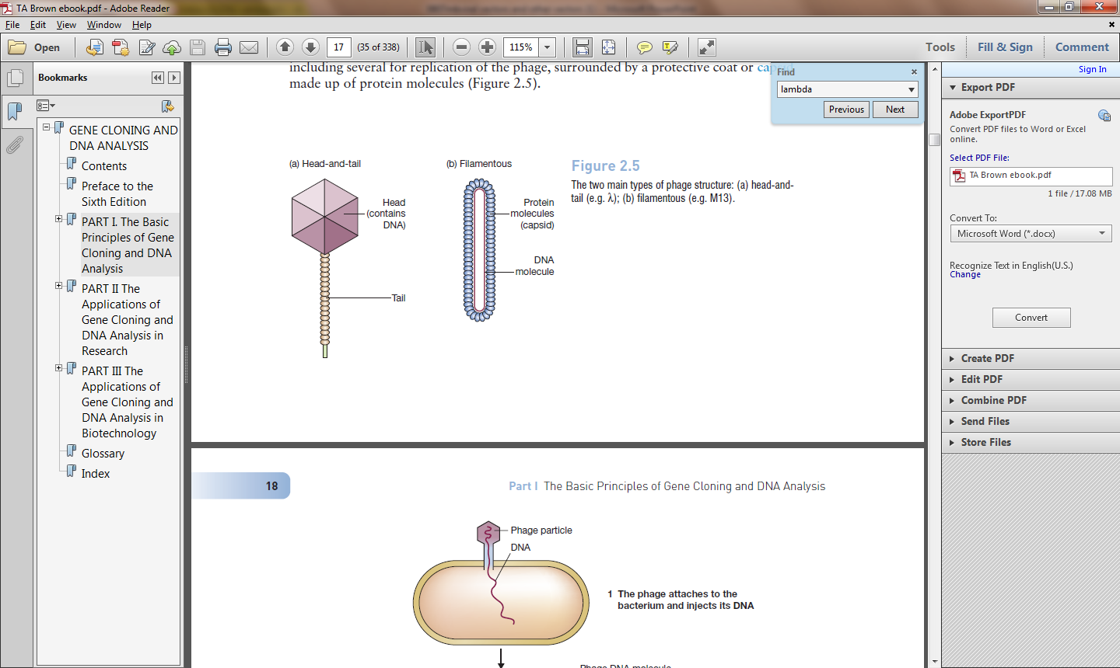
Bacteriophage
Plasmid Vectors
Lambda Vectors
Selection of Recombinants
Cosmid Vectors
M13 Vectors- (ssDNA prep)
Phagemid Vectors
BAC vectors
YAC vectors

Slide 3
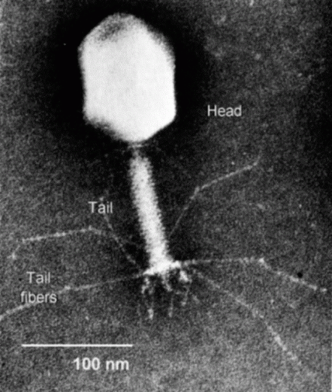
Viral vectors
1. Bacteriophage Lambda
Virus of E.coli
Lytic or Lysogenic life style
Virulent phage
do not integrate their DNA into the host bacterium genome and they usually kill the host (lytic)
Temperate phage may integrate into the host genome causing lysogeny

Slide 4
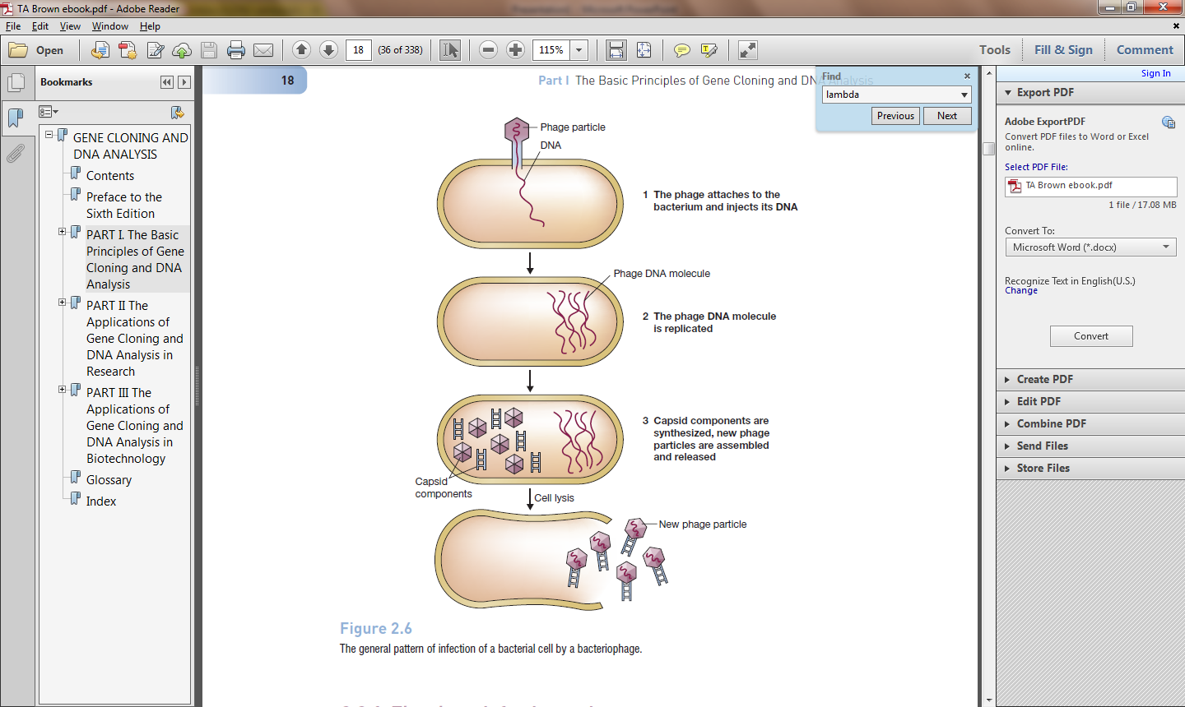
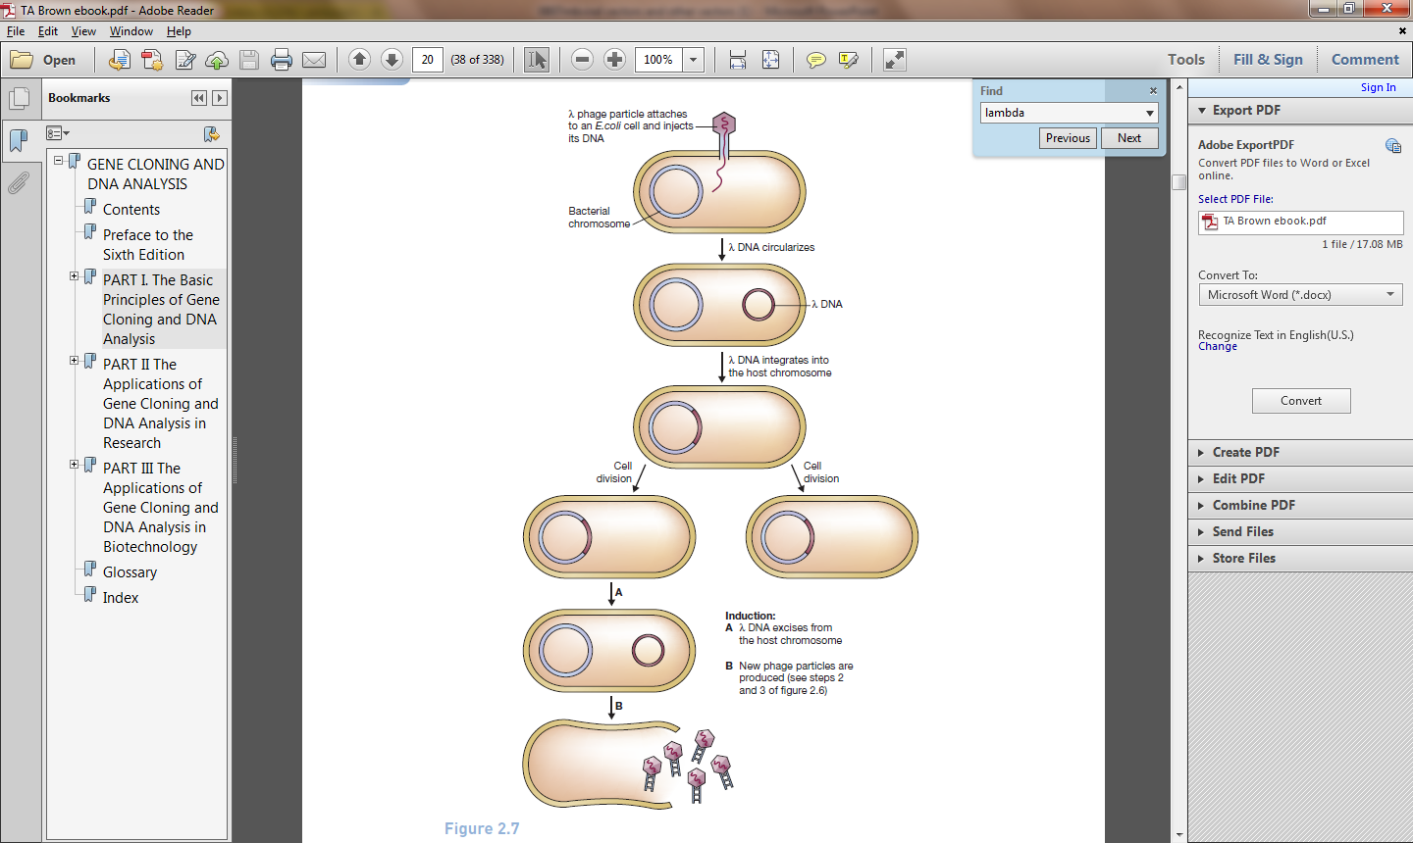
Lytic Life Cycle
Lysogenic Life Cycle

Slide 5
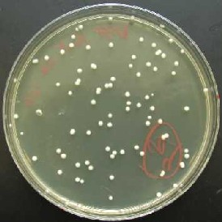
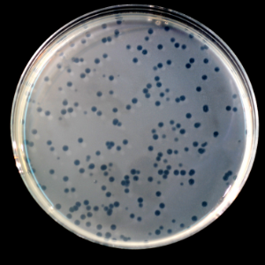
The infection process is about thousand times more efficienct than transformation with plasmid vectors.
10⁶ tansformed colonies per microgram of plasmid vector
10⁹ plaques per microgram of recombinant Lambda vector
Bacterial Colonies
Viral Plaque

Slide 6
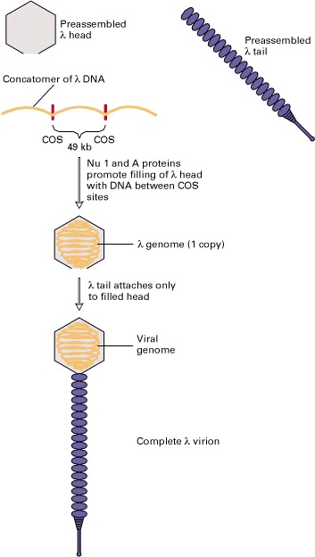
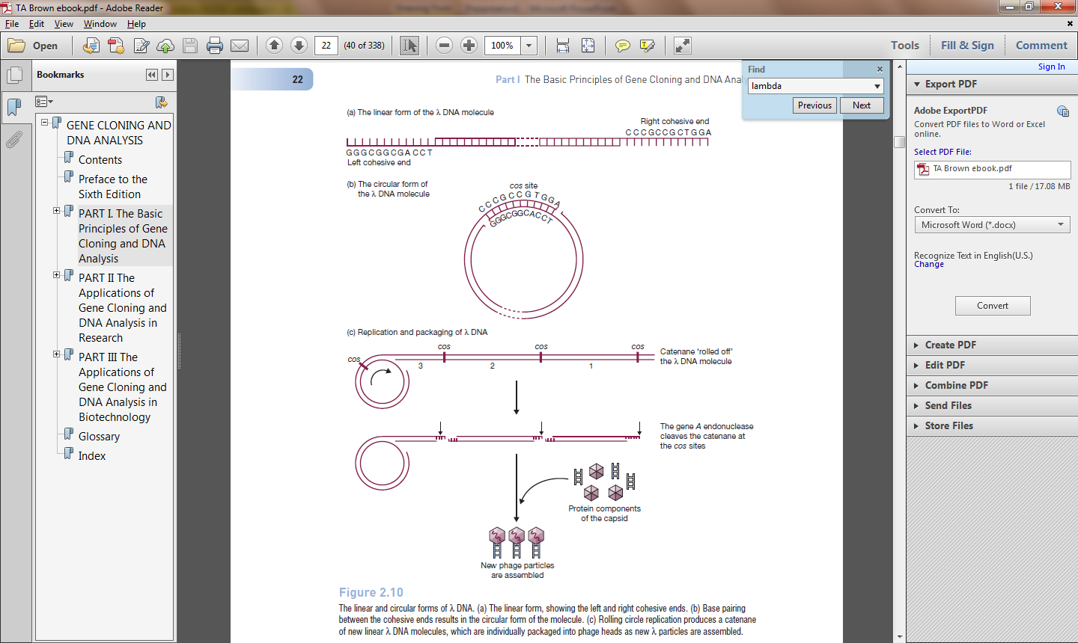
Lambda Phage
49kb, linear, dsDNA
Assembly of bacteriophage λ virions
Notes:
CIRCULARIZATION IS A PREREQUISITE FOR INSERTION INTO BACTERIAL GENOME.
During the in vivo assembly of λ virions within infected host cells, viral heads and tails initially are assembled separately, from multiple copies of the various proteins that compose these complex structures. Replication of λ DNA in a host cell generates long multimeric DNA molecules, called concatomers, that consist of multiple copies of the viral genome linked end to end and separated by specific nucleotide sequences called COS sites. Two λ proteins, designated Nu1 and A, bind to COS sites and direct insertion of the DNA lying between two adjacent COS sites into a preassembled head. This process results in the packaging of a single ≈50-kb λ genome from the multimeric concatomer into each preassembled head. Host-cell chromosomal DNA is not inserted into the λ heads because it does not contain any copies of the COS sequence. Once λ DNA is inserted into a preassembled λ head, the preassembled tail is attached, producing a complete virion

Slide 7
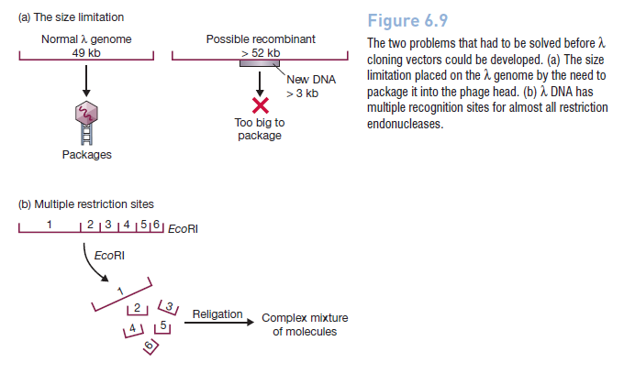
Cloning Vectors based on Lambda Phage Problem-Packaging efficiency 78%-105% of the lambda genome.
Problem- Multiple Restriction Sites

Slide 8
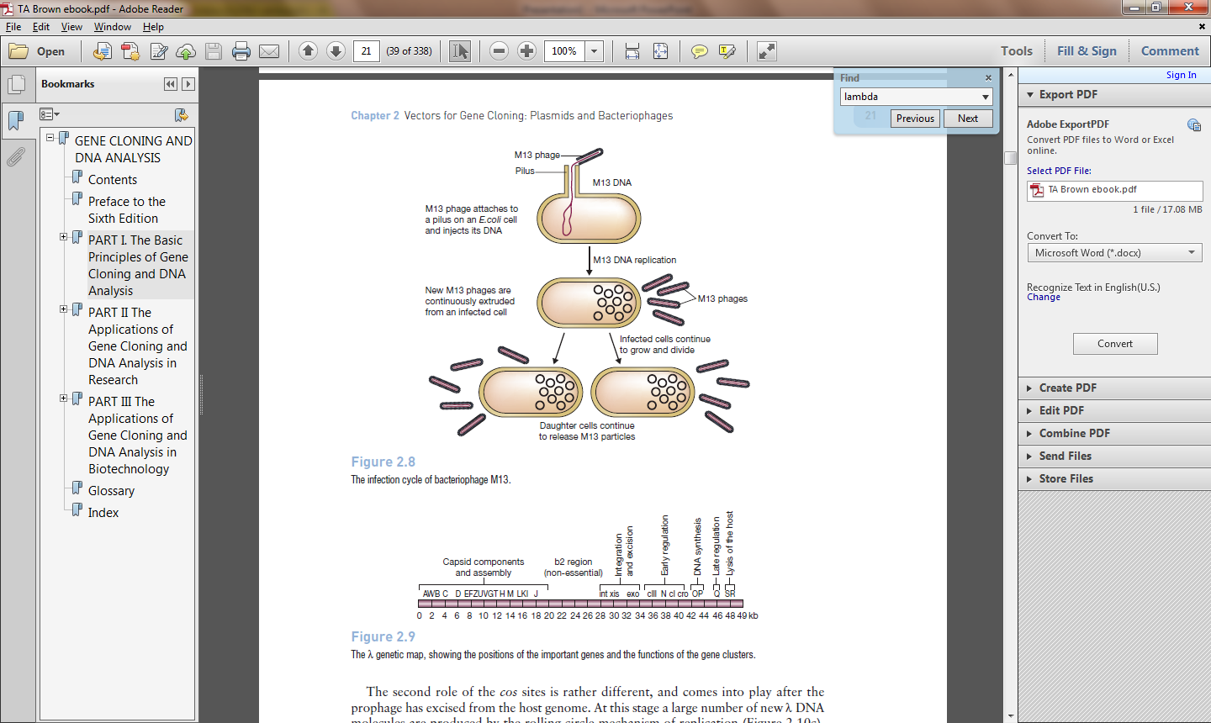
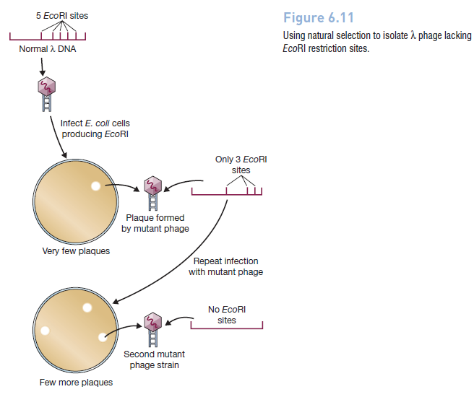
Segments of the L genome can be deleted without impairing viability
Deleted region
Notes:
Phage DNA molecules generally carry several genes that are essential for
replication, including genes coding for components of the phage protein coat and phagespecific
DNA replicative enzymes. Alteration or deletion of any of these genes will
impair or destroy the replicative ability of the resulting molecule. There is therefore
much less freedom to modify phage DNA molecules, and generally phage cloning vectors
are only slightly different from the parent molecule.

Slide 9
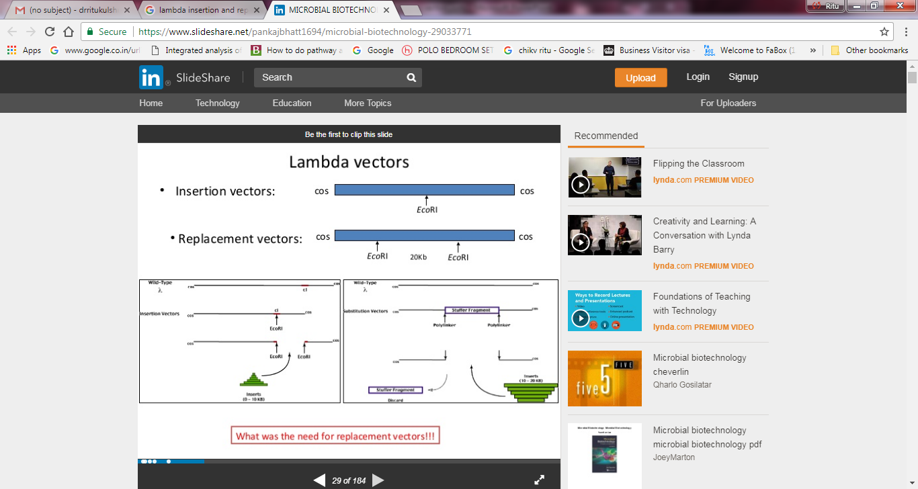

Slide 10
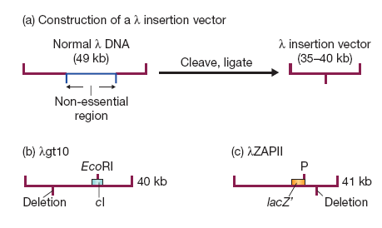
Lambda Insertion Vectors
Disruption of cI gene- cI promotes lysogeny, thus, recombinants are distinguished as clear rather than turbid plaques
Disruption of lacZ’- Recombinants give clear rather than blue plaques on X-gal agar.
Notes:
Please read-
http://faculty.tru.ca/dnelson/courses/biol335/335notes/3recdna/2-vectors/lambda%20vectors/recDNA5b.html

Slide 11
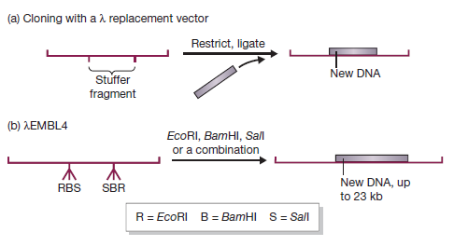
Lambda Replacement Vectors
Notes:
The lambda packaging system, which assembles the mature phage particles, can only insert DNA molecules of between 37 and 52 kb into the head structure. Anything less than 37 kb is not packaged. Many lambda vectors have been constructed by deleting large segments of the lambda DNA molecule and so are less than 37 kb in length. These can only be packaged into mature phage particles after extra DNA (stuffer fragment) has been inserted, bringing the total genome size up to 37 kb or more. Therefore, with these vectors only recombinant phages are able to replicate.

Slide 12
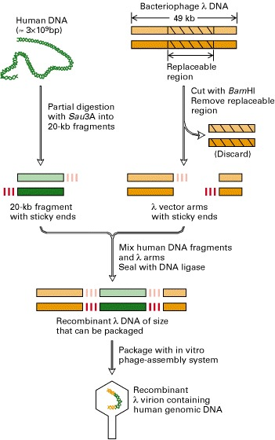
Construction of a genomic library of human DNA in a bacteriophage λ vector.

Slide 13
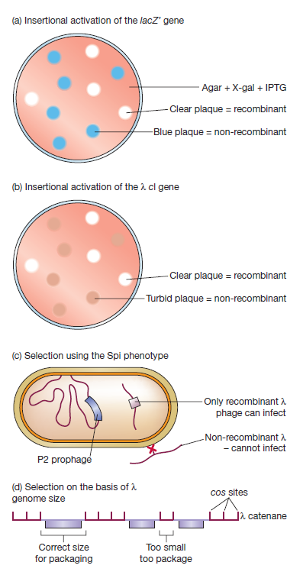
Strategies for selection of recombinant phages
Notes:
Several types of lambda cloning vector have unique restriction sites in the cI gene (map position
38 on Figure 2.9). Insertional inactivation of this gene causes a change in plaque
morphology. Normal plaques appear “turbid”, whereas recombinants with a disrupted
cI gene are “clear” (Figure 5.13b). The difference is readily apparent to the experienced eye.
5.4.3 Selection
Spi (sensitive to P2 infection) phenotype
P2 bacteriophage is already inserted into the genome of E.coli. It prevents reconstituted lambda bacteriophage from growing. Note Insertion excision bit is removed and only the lytic cycle can be followed in the recombinant phage..
Replacement of lambda DNA containing the red and gam genes in the lambda EMBL3 genomic DNA cloning vector with BamHI compatible DNA inserts of ~10-20 kb, permits lytic growth of recombinant phage in E. coli strains containing the P2 bacteriophage lysogen.

Slide 14
The need for vectors with larger inserts Genomic Libraries

Slide 15
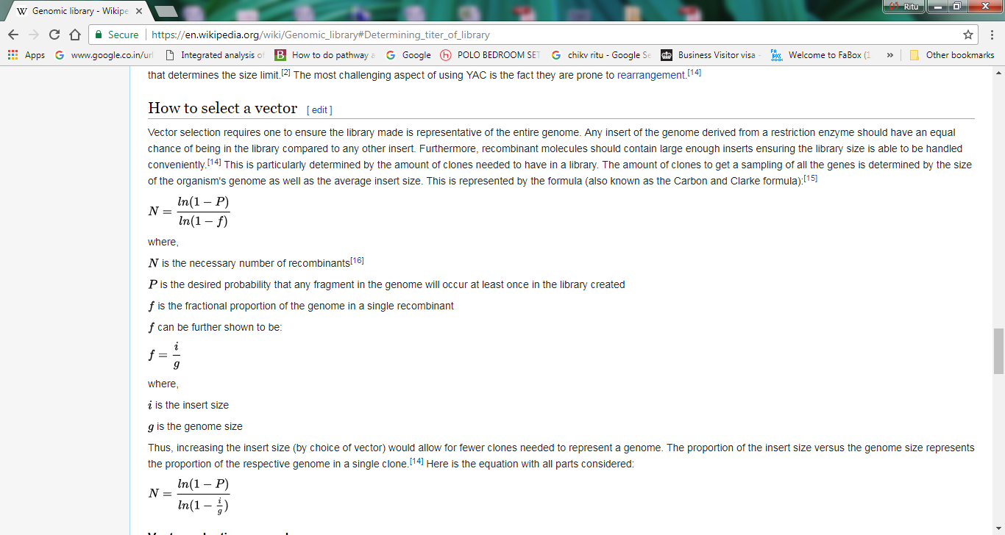

Slide 16
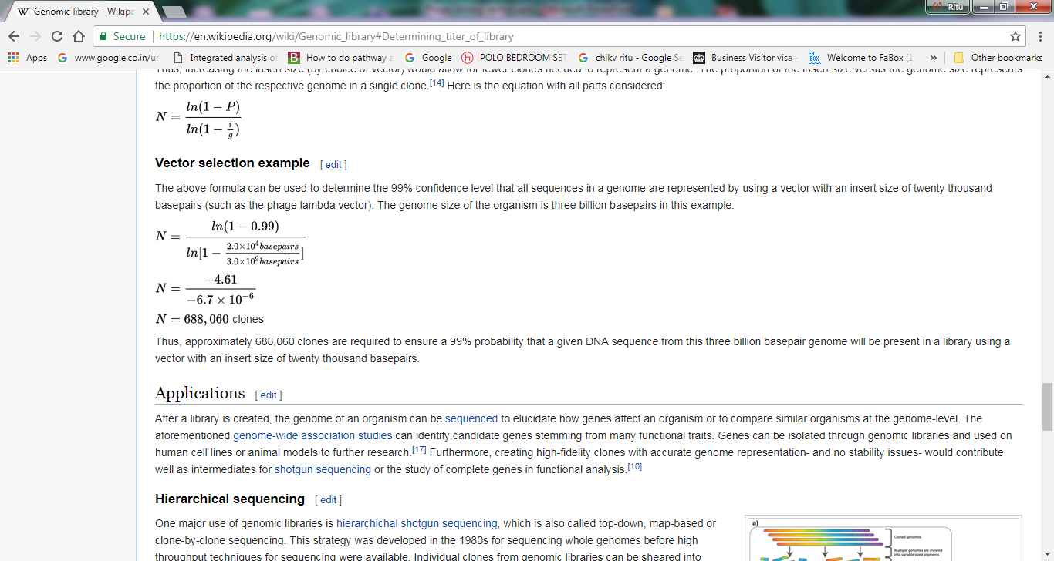

Slide 17
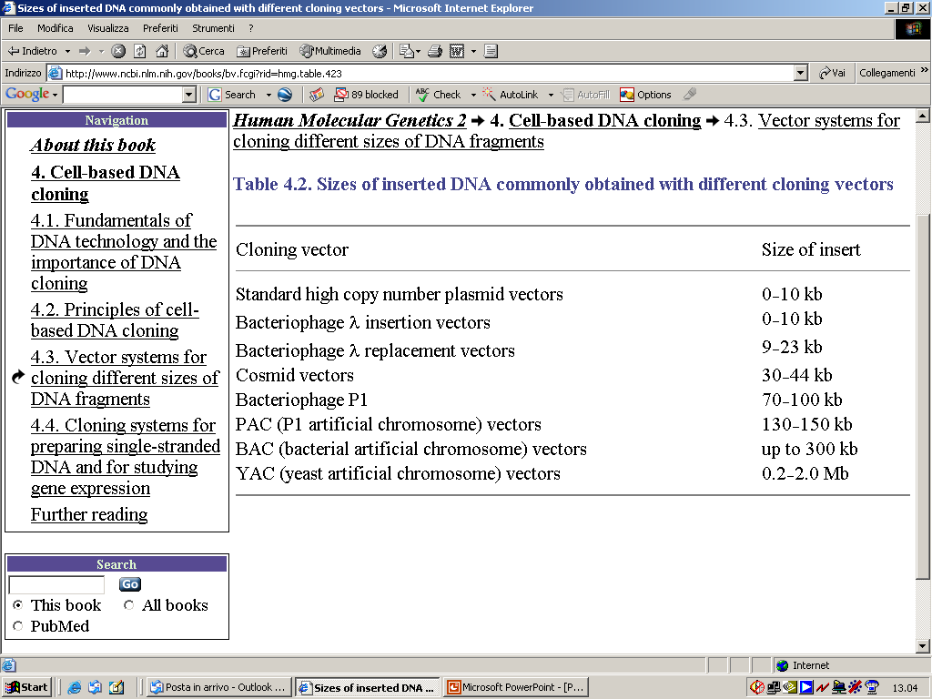

Slide 18
Cosmids-Long DNA fragments can be cloned using a cosmid
Refer:
https://www.ncbi.nlm.nih.gov/books/NBK21696/

Slide 19
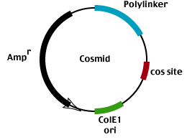
Cosmids
Cross between phage and plasmid
Circular ds DNA
Contain cos sites and can be packaged into phage heads
Carry more DNA than plasmid and can be maintained and manipulated as plasmids
Cloning using cosmids
Clone into vector as would with plasmid
Introduce DNA to cell as you would with phage
Propagate as you would a plasmid
Cosmids have about 5kb DNA and therefore can get ~ 33-48kb foreign DNA into a phage head.

Slide 20
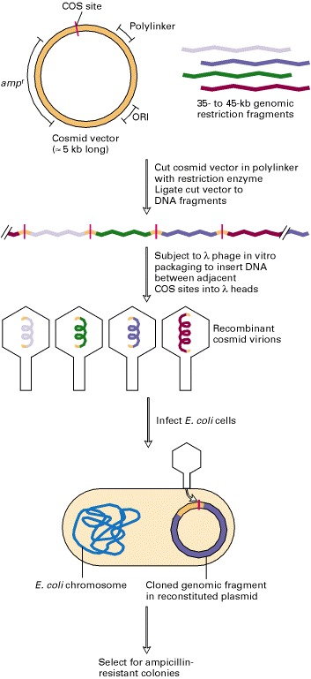

Slide 21
In-vitro packaging

Slide 22
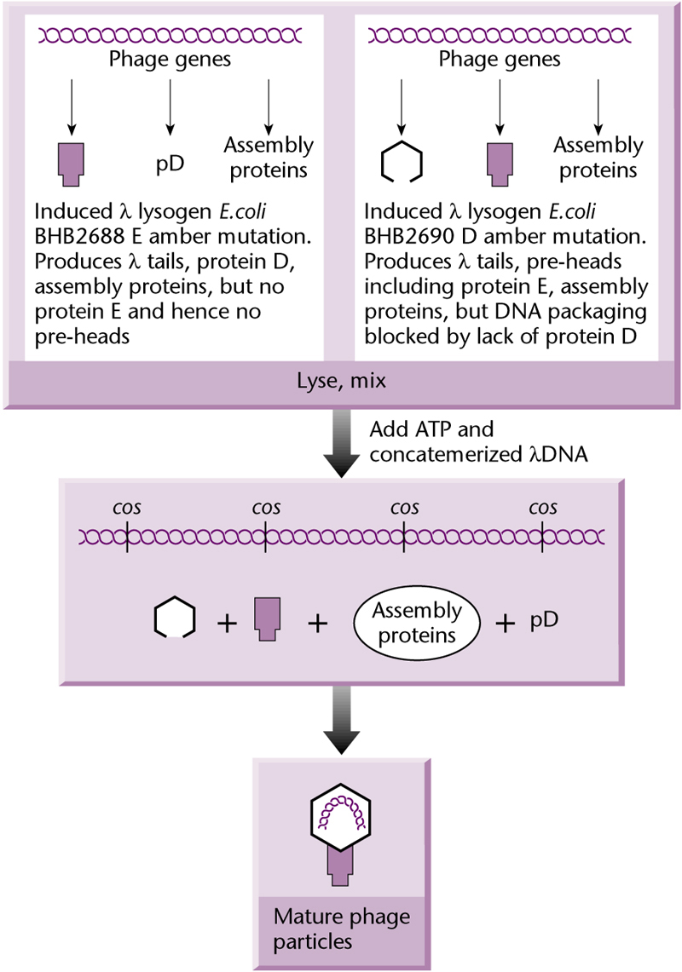
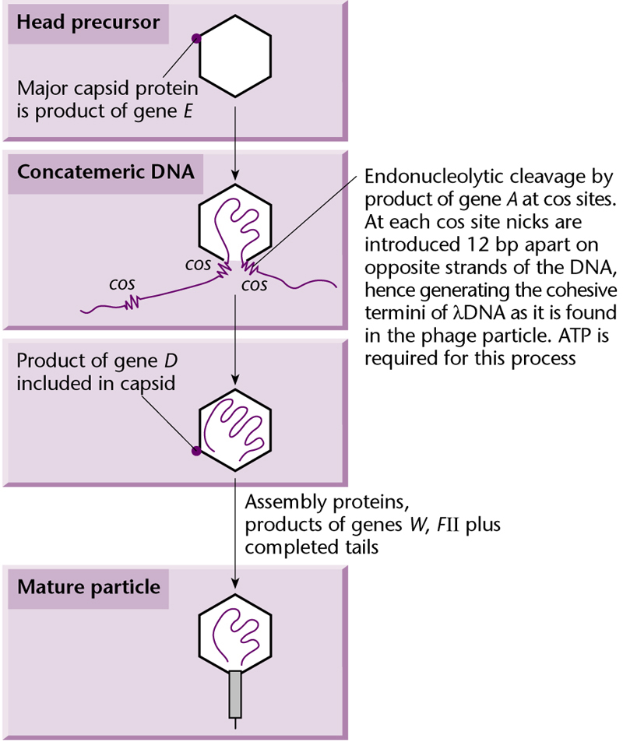
The packaged phage particles are infectious
How to transfer recombinant lambda into cells?

Slide 23
Other vectors
Other high-capacity vectors have been constructed from bacteriophage
P1, which has the advantage over lambda of being able to squeeze 110 kb of DNA into its capsid structure.
Cosmid-type vectors based on P1 have been designed and used to clone DNA fragments ranging in size from 75 to 100 kb.

Slide 24
M13 Phage
6.4 kb, circular, ss DNA

Slide 25
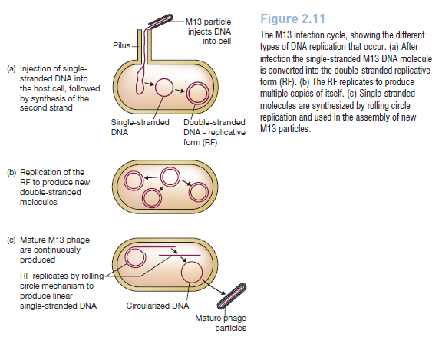

Slide 26
M13 as cloning vector-Advantages
The genome is less than 10 kb in size(~6.4 KB), well within the range desirable for a potential vector. In addition,
The double-stranded replicative form (RF) of the M13 genome behaves very much like a plasmid, and can be treated as such for experimental purposes (It is easily prepared from a culture of infected E. coli cells).
Most importantly, genes cloned with an M13-based vector can be obtained in the form of single-stranded DNA. Single-stranded versions of cloned genes are useful for several techniques, notably DNA sequencing and in vitro mutagenesis.
M13 vectors are also used in phage display, a technique for
identifying pairs of genes whose protein products interact with one another.
Notes:
Life cycle. Filamentous phage attach to the F-pili of E. coli and inject single-stranded
circular DNA into the bacteria. The ssDNA is converted to a dsDNA form known as replicative
form (RF). The replicative form behaves as a plasmid within the bacteria and undergoes
multiple rounds of replication. It is this replicative form that is isolated and manipulated as a
cloning vector. Foreign DNA can be incorporated into cloning sites and bacteria transformed by
standard procedures. Structural genes are transcribed from the replicative form and the ssDNA
genome is produced from a special replication origin (usually called the f1 origin). The product
of gene II forms a nick in the initiation site of the f1 replication origin. Host DNA polymerases
replicate the phage DNA starting at the nick and displace one strand will progressing along the
template. When the polymerase completes the
circle, the gene II product cleaves the displaced
strand at the termination site within the replication
origin and the ssDNA is circularized.
The ssDNA is packaged at the membrane of the bacteria and the mature phage is
extruded without lysing the cell. Phage particles containing ssDNA are isolated from the culture
supernatant medium by differential centrifugation and the ssDNA is extracted from the phage
particles. The phage can also be plated on a bacterial lawn to produce plaques. However, these
plaques are 'fuzzy' since they are not formed as a result of cell lysis, but formed as a result of
diminished host cell growth.

Slide 27
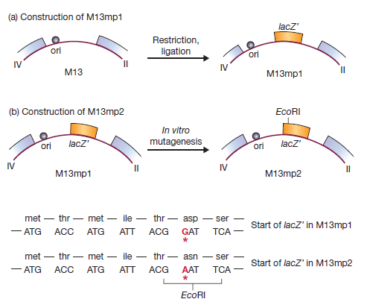
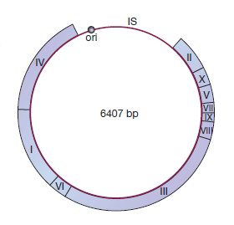
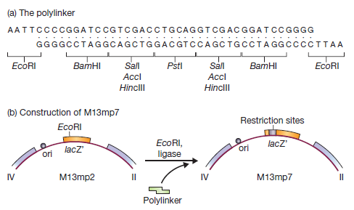
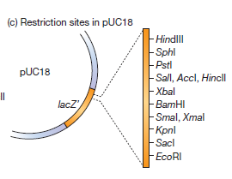
M13 cloning vectors
M13mp8 with same MCS as PUC8

Slide 28
Phagemids: plasmid/M13 hybrids
Plasmids containing both plasmid (colE1) origin and bacteriophage M13 origin of replication
To recover single-stranded version of the plasmid (for sequencing, e.g.), infect transformed strain with a helper phage (M13KO7)
Helper phage cannot produce single stranded copies of itself (bcoz ori is mutated), but provides replication machinery for single-stranded copies of the phagemid DNA and packaging of the phagemid.
Phagemid single stranded DNA is packaged and extruded into supernatant--can then be isolated for sequencing, etc.

Slide 29
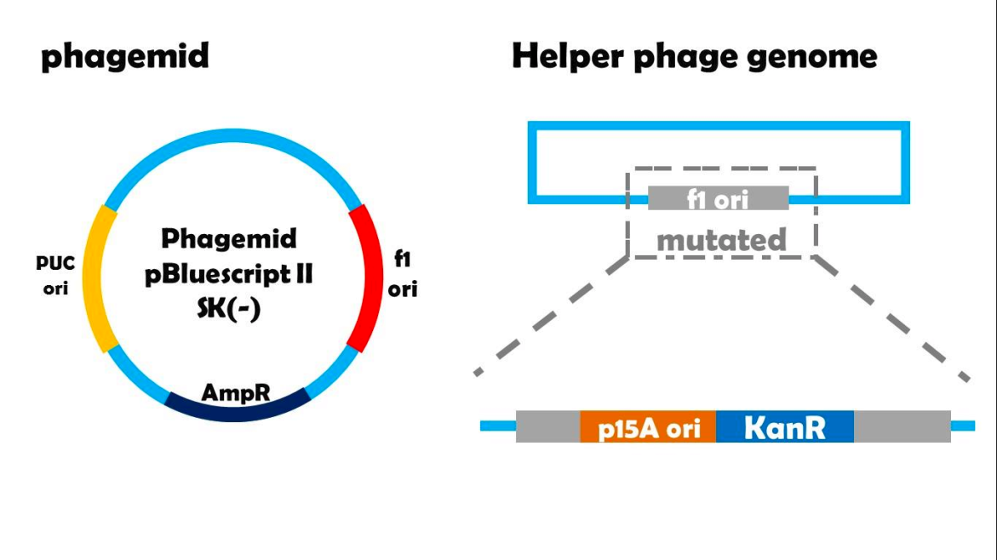

Slide 30
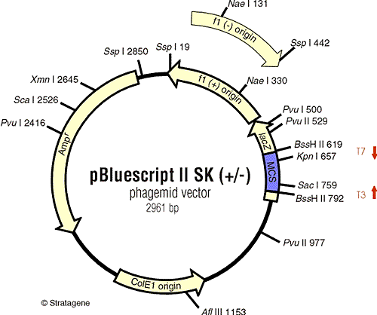

Slide 32
BACs: Bacterial Artificial Chromosomes
Based on the F factor of E. coli:
--100 kb plasmid, propagates through conjugation
--low copy number (1-2 copies per cell)
--2 genes (parA and parB): accurate partitioning during cell division
BACs: just have par genes, replication ori, cloning sites, selectable marker
Can propagate very large pieces of DNA:
up to 300 kb
Move into cells through electroporation.
Notes:
The F factor plasmid has the ability to continue to function even when integrated into a complete bacterial chromosome.
Highly modified F plasmids have been generated that are capable of cloning very large inserts of up to 300 kb.
One feature is the incorporation of cut sites for restriction endonucleases with eight base cut sites.
Such endonucleases cut DNA less frequently and thus generate larger fragments for cloning.
Bacterial artificial chromosomes are sometimes introduced into their host cells by electroporation, which consists of a brief treatment with high voltage electric current that momentarily disrupts the cell membranes and facilitates entry of large DNA molecules.
Once in the cell, the BAC replicate like F plasmids.

Slide 33
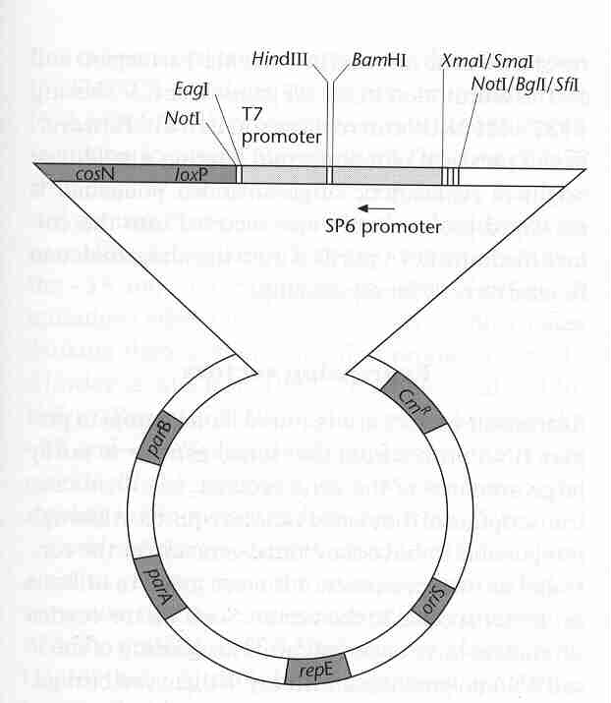
General BAC vector
Cloning, etc
selection
7 kb
replication
Notes:
repE for plasmid replication and regulation of copy number.parA and parB for partitioning F plasmid DNA to daughter cells during division and ensures stable maintenance of the BAC.A selectable markerfor antibiotic resistance; some BACs also have lacZ at the cloning site for blue/white selection.T7 & Sp6phage promoters for transcription of inserted genes.
The original BAC vector, pBAC108L, is based on a mini-F plasmid, pMBO131 which encodes genes essential for self-replication and regulates its copy number inside a cell. The unidirectional self-replicating genes are oriS and repE while parA and parB maintain copy number to one or two for each E. coli genome. Added to the vector were multiple cloning sites flanked by “universal promoters” T7 and SP6, all flanked by GC-rich restriction enzyme sites for insert excision. cosN and loxP sites were cloned in (by bacteriophage l terminase and P1 Cre recombinase, respectively) to permit linearization of the plasmid for convenient restriction mapping. Additionally, there is a chloramphenicol resistance gene for negative selection of non-transformed bacteria.
A direct method of labelling BAC clones by linearising with Cre recombinase at the unique loxP site. The resultant linear molecule, labelled at either strand, can be partially digested with restriction enzymes, and the products analysed by pulse field, or field inversion gel electrophoresis.

Slide 34
YACs: Yeast Artificial Chromosomes
SUP4 gene, a suppressor tRNA gene which overcomes the effect of the ade-2 ochre mutation and restores wild-type activity.
Based on the chromosome of Yeast
Features:
CEN1, centromere sequence→segregation
TEL, telomere sequences→extremity protection
ARS1, autonomous replicating sequence→replication
Amp
ori, origin of replication for propagation in an E. coli host.
Notes:
Cloning of exogenous DNA into bacterial artificial chromosomes (BACs) pro vides a new approach to the analysis of the genomes of higher organisms [1]. BAC libraries containing large genomic DNA inserts are important tools for positional cloning, physical mapping and genome sequencing. A number of human and plant BAC libraries have been constructed (e.g., human: [2], Arabidopsis: [3], rice: [4], sorghum: [5]). Bacterial artificial chromosome vectors utilize the rE. coli single-copy fertility plasmid and can maintain genomic DNA fragments up to 350 kb. Very little or no rearrangement of the inserts or chimerism have been observed [1, 5–7]. Other systems for the cloning of large DNA fragments have been developed. The development of yeast artificial chromosome vectors (YAC: [8]) permits cloning of fragments of greater than 500 kb. However, some disadvantages of the YAC system include a high degree of chimerism and insert rearrangement that limit its usefulness [9–11]. Systems based on the bacterial F-factor (BAC: [1]) and bacteriophage Pl (PAC: [12]) have much higher cloning efficiencies, improved fidelity, and greater ease of handling as compared to the YAC system. Because of BAC clone stability and ease of use, the BAC cloning system has emerged as the system of choice for the construction of large insert genomic DNA libraries.
Chimerism may be due to either co-ligation of multiple genomic segments into a single YAC, or recombination of two or more YACs transformed in the same host Yeast cell.^{[16]} The incidence of chimerism may be as high as 50%.^{[17]} Other artifacts are deletion of segments from a cloned region, and rearrangement of genomic segments (such as inversion). In all these cases, the sequence as determined from the YAC clone is different from the original, natural sequence, leading to inconsistent results and errors in interpretation if the clone's information is relied upon. Due to these issues, the Human Genome Project ultimately abandoned the use of YACs and switched to bacterial artificial chromosomes, where the incidence of these artifacts is very low.

Slide 36
SUP4, which is the marker into which new DNA is inserted during the cloning experiment.
(SUP4 gene, a suppressor tRNA gene which overcomes the effect of the ade-2 ochre mutation and restores wild-type activity, resulting in colorless colonies.
SUP4 gene compensates for a mutation in the yeast host cell that causes the accumulation of red pigment. The host cells are normally red, and those transformed with YAC only, will form colorless colonies. Cloning of a foreign DNA fragment into the YAC causes insertional inactivation of the gene, restoring the red color. Therefore, the colonies that contain the foreign DNA fragment are red.⁾
The host cells are also designed to have recessive trp1 and ura3 alleles which can be complemented by the corresponding TRP1 and URA3 alleles in the vector, providing a selection system for identifying cells containing the YAC vector.
URA3- This gene codes for orotidine-5′-phosphate decarboxylase (an enzyme that catalyzes one of the steps in the biosynthesis pathway for pyrimidine nucleotides) and is used as a selectable marker.
TRP1. This gene, which is involved in tryptophan biosynthesis, is located adjacent to a chromosomal origin of replication.

Slide 38
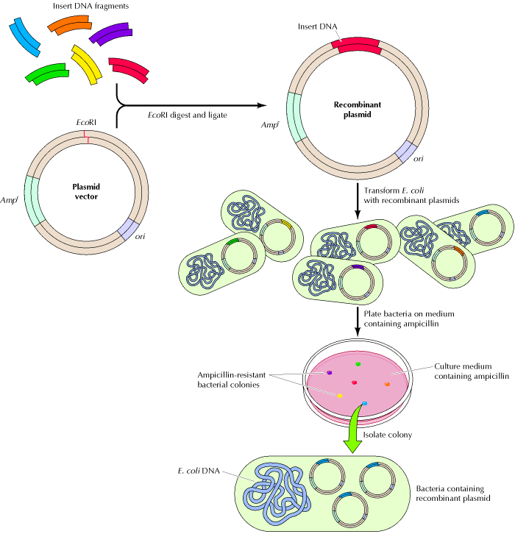
Not all vectors permit
the identification of the desired clones by simple selection or color based strategies.
In the majority of cases we need alternative approaches!!!!

Slide 39
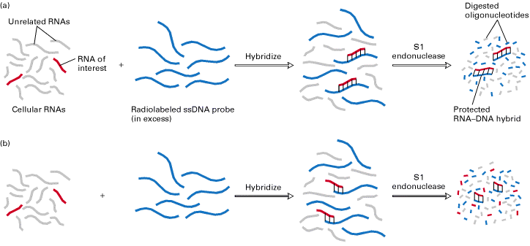

Slide 40
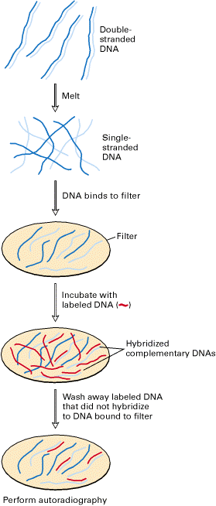
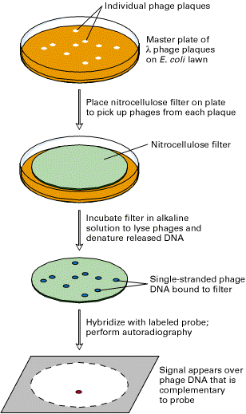
Identification of a specific clone from a library by membrane hybridization to a radiolabeled probe

Slide 41
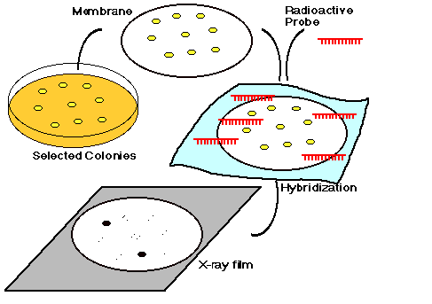

Slide 42
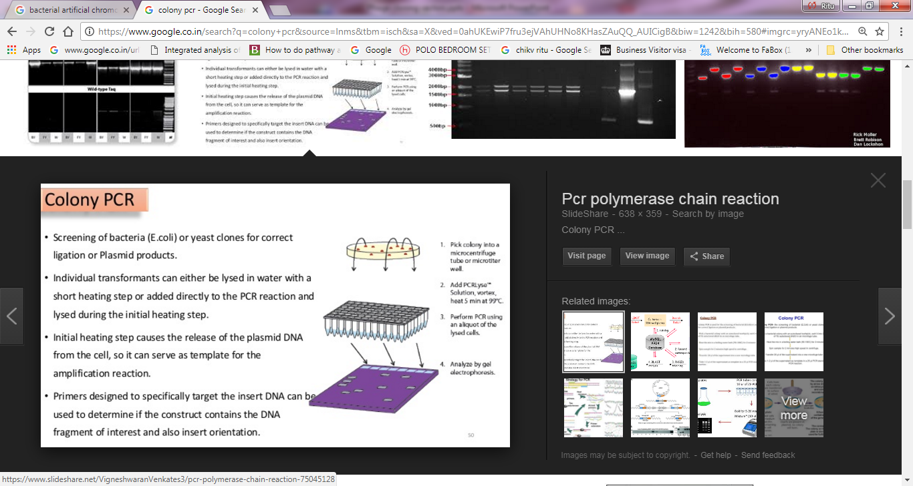

Slide 43
Immunological Screening
Antibodies to the protein encoded by the desired gene can be used to screen a library

Slide 44
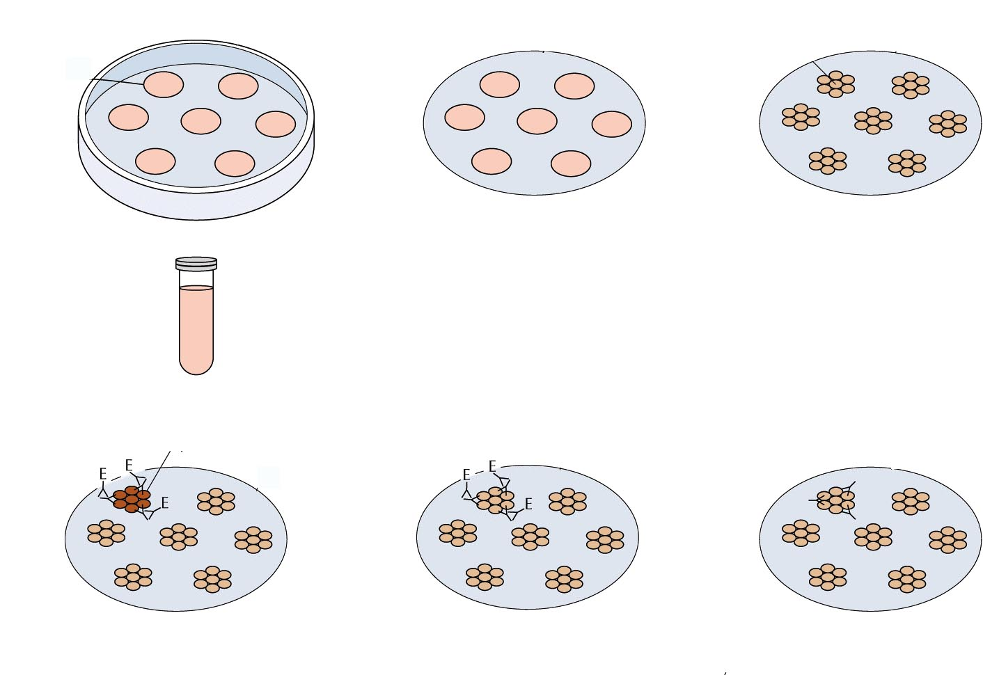
Immunological Screen
master plate
matrix
cells
protein
1
2
6
transfer
cells
lyse cells
bind protein
subculture
cells from
master plate
3
Add 1°Ab;
wash
positive
signal
5
4
Add substrate
Add 2°Ab-Enzyme
wash

Slide 45


Immunological Screen of Library
detectable
product
substrate
reporter enzyme
2° Ab
1° Ab
target protein
matrix

Slide 46
